Slide 1
Hotel Aggregator Analysis
by Tonderai Mapwashike

Slide 2
Objective
The objective is to create
comprehensive visualizations and insights that shed light on trends, patterns, and factors influencing the
performance of listings. Through Power BI, interns will explore key metrics such as pricing, availability,
host characteristics, and review scores to derive actionable insights for improving the overall quality and
competitiveness of the listings.

Slide 3

Dataset Description
1. id: Unique identifier for each listing.
2. listing_url: URL of the listing on the hotel aggregator platform.
3. scrape_id: Identifier for the data scraping event.
4. last_scraped: Date of the last data scrape.
5. source: Source of the listing information.
6. name: Name of the listing.
7. description: Description of the listing.
8. neighborhood_overview: Overview of the neighborhood where the listing is located.
9. picture_url: URL of the listing's picture.
10. host_id: Unique identifier for the host.
11. ... (and many more columns capturing details about hosts, location, property type, room details,
amenities, pricing, availability, reviews, and other relevant information)

Slide 4
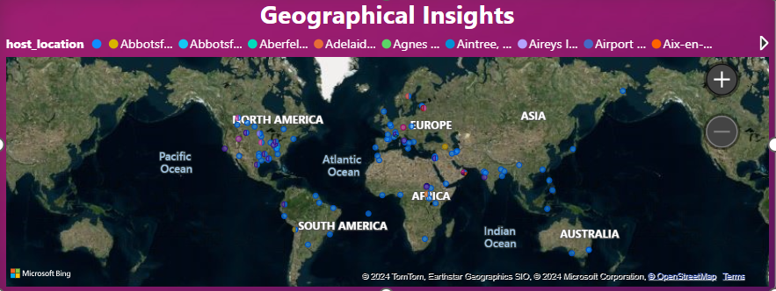
Geographical Insights

Slide 5
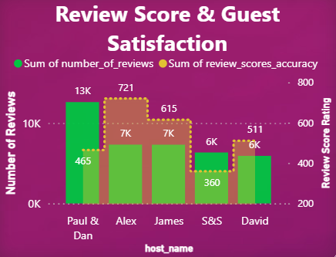
Review Scores and Guest Satisfaction

Slide 6
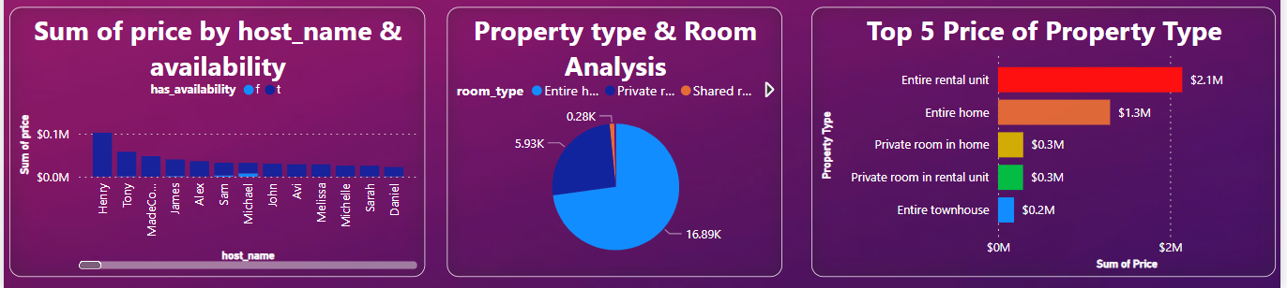
Pricing and Availability Analysis

Slide 7
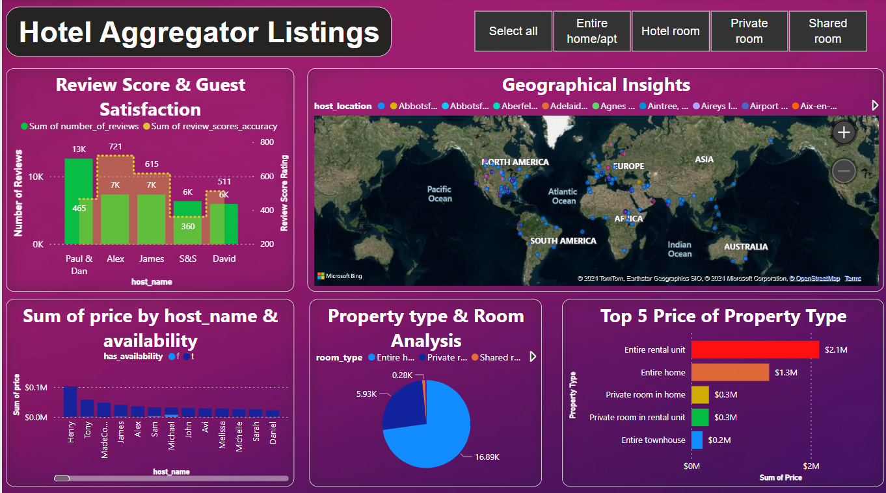
Property Type and Room Analysis

Slide 8

Conclusion
Australia has the highest number of listing
The shared room type is more affordable than other room types
Homes/apt are the most expensive than private and hotel
Large accommodation tends to have higher prices

